Slide 1

Misinformation detection on Twitter using ATA GNN
Victoria Kildyushevskaya

Slide 2
Topic and its significance
Social media is a common way to share information, opinions and news since the world has become more interconnected. Misinformation dissemination can pose a danger to stability and even physical safety of people and even influence the election campaigns (Horne & Adali, 2017).
Fake news is rarely verified by the users, and the more fear, disgust, and surprise are triggered the faster it spreads by and among the participants (also due to their novelty) (Vosoughi, 2018).
The identification of misinformation has been tackled successfully by many researchers, but the open topic remains the prevention of misinformation propagation. While Models are created and tested on existing static data, the fake news continue to spread in the real world.
Anticipating fake news proliferation and its timely prevention can be done on the levels of legislation (hate speech ban), companies (Facebook, Twitter policies), and voluntary - crowdsourcing like on Sina Weibo but is difficult in real time otherwise since the news are generated constantly every second (Shu et al., 2017)

Slide 3
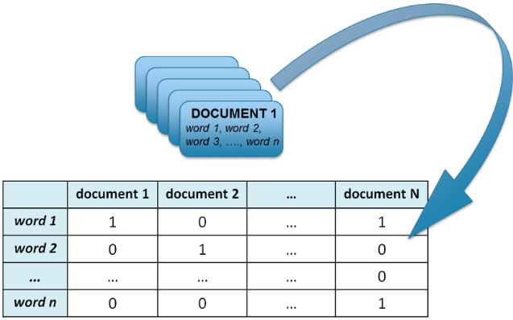
Natural Language Processing introduction
NLP Goal: use text as input and process / analyse large amounts of unstructured data
Machines do not understand the text directly so mapping text to numbers is a challenge
Document = Tweet
To convert text – Vector Space Models
Statistical features (Moorthy, 2025): Bag of Words / TF-IDF, Topic modelling – LDA clustering, Word Embeddings - grouping similar words together in vector space using Vocabulary Mapping (Mikolov 2013) -> Modelling

Slide 4
NLP process
Text processing
Feature engineering
Model Training and Evaluation

Slide 5
Models used to detect misinformation
Language models used from the Literature Review:
RNNs, LSTMs (tackled the problem of exploding gradients by using sigmoid function), GRU (Gated recurrent unit) – reduced number of computations so runs faster than LSTM. Other models like Glove, TF-IDF, CNN, GAT, Graph, LDA, Transformer based BERT, GPT3.
Transfer Learning - pretrained ALBERT, IndoBERT, mBERT, ROBERTA, embedding level
RNNs are sequential -> transformers are parallelized and rely on self-attention layers (J. Alamar 2018)
in 2017 the paper was published about transformers by Vasivani et al. called “Attention is all you need” transformers outperformed all sequential tasks) since transformers encode the words better drawing on the cues from other positions – adds to the missing context of NL. GPT is a transformer-based model

Slide 6
Key Literature
While sequential models are still in use - the transformer-based models outperform on NLP tasks
Two studies have exceptional results when it comes to model evaluation:
Text only ATA GNN study by Patel (2025) using soft LDA for source tweets (ethical, practical, 93% accuracy)
Hybrid study by Moorthy (2025) - BERT for text analysis and GNN for propagation modelling to detect fake news achieving 99% accuracy
Propagation structure increased accuracy
Two main approaches to identify misinformation:
1 Text only as input
2 Text + propagation structure of misinformation / user context (hybrid)
3 Multimodal approach Text + Images (Dong et.al, 2023)
4 Behaviours that drive search and sharing of sensational fake news (Dong et al., 2023)
Gap - lack of real-time application

Slide 7
Main Themes
Text-only for misinformation detection (Patel, 2025) versus text and propagation (Moorthy 2025, Twum 2019)
Graphs (Patel, 2025), transformers (Azizah, 2023), what is most effective and what is the complexity of computation trade off
Ethical privacy constrains when it comes to network analysis
Generalization of the models across languages apart from English since most datasets are in English – creating multilingual misinformation detection (Horne & Adali, 2017)
Complexity of multimodal nature of social media platforms (Dong et al, 2023)
Constant evolvement of misinformation methods and their variety (memes, deepfakes, videos, images, etc)
Lack of real time implementation and prevention of misinformation proliferation

Slide 8
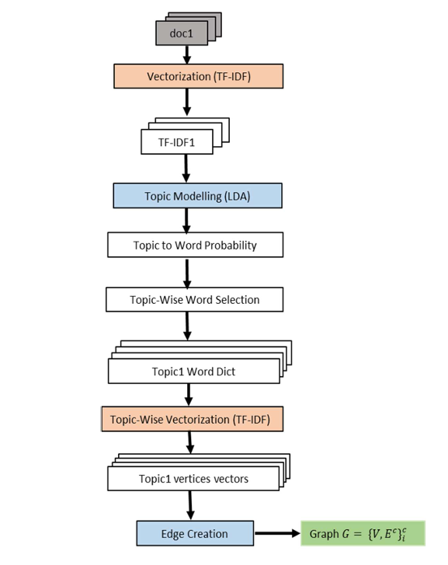
Research Question
My aspiration is to test proposed architecture in real time on Twitter and explore how the identified fake news spread
To define potential viral tweets using text and check the propagation using GNN afterwards
But firstly, I would like to advance Patel’s model and use LLM based tokenization and embedding instead of TF-IDF (image - Graph creation steps (Patel, 2025)

Slide 9
Aims and Objectives
Goal is to compare TF-IDF with LLM embeddings like miniLM / SBERT in graph creation
H0 – there is no difference in model’s efficiency if TF-IDF is replaced with LLM embeddings
H1 – there is a difference
Rationale: To increase model’s efficiency, capture contextual information, and generate documents’ initial vector (LLM) based tokenization and embedding techniques should be used instead of word tokenization and vectorization technique
Significance: Advancing state of the art model architecture which is ethical and effective and uses only text input
Notes:
.

Slide 10
Research Design
.
Data preprocessing: datasets to use - Twitter15, Twitter16, PHEME, use only Source Tweets and binary labels True/False
Build one graph per topic (LDA)
Encode each tweet using sentence/document embeddings LLM model (and TF-IDF for comparison)
Construct graph for each identified topic
Train the model and evaluate it using Accuracy, Precision, F1 score metrics

Slide 11
Project Timeline
Step 1 (two weeks) Text prepossessing, training LDA, building topic dictionaries and features TF-IDF
Step 2 (two weeks) : Integrating LLM embeddings – choose suitable LLM model
Step 3 (two weeks): Hyperparameter tuning
Step 4 (two weeks): Ensuring model reliability and calibrating confidence scores
Step 5 (two weeks): Comparing results for TF-IDF vs embeddings and evaluating errors
Step 6 (two weeks): Creating artefact, writing report, submitting results

Slide 12
THANK YOU!

Slide 13
Bibliography
Alammar, J. (2021). Ecco: An Open Source Library for the Explainability of Transformer Language Models. Proceedings of the 59th Annual Meeting of the Association for Computational Linguistics and the 11th International Joint Conference on Natural Language Processing: System Demonstrations, 249–257. https://doi.org/10.18653/v1/2021.acl-demo.30
Horne, B., & Adali, S. (2017). This Just In: Fake News Packs A Lot In Title, Uses Simpler, Repetitive Content in Text Body, More Similar To Satire Than Real News. Proceedings of the International AAAI Conference on Web and Social Media, 11(1), 759–766. https://doi.org/10.1609/icwsm.v11i1.14976
Azizah, S. F. N., Cahyono, H. D., Sihwi, S. W., & Widiarto, W. (2023). Performance Analysis of Transformer Based Models (BERT, ALBERT and RoBERTa) in Fake News Detection (Version 1). arXiv. https://doi.org/10.48550/ARXIV.2308.04950
Dong, L., Mohd Nor, N. H., Kai, G. B., Muhamad Adzmi, A., & Abdul Rais, S. S. (2023). Fake News Sharing Among Weibo Users in China. Jurnal Komunikasi: Malaysian Journal of Communication, 39(4), 284–305. https://doi.org/10.17576/JKMJC-2023-3904-15
Mikolov, T., Chen, K., Corrado, G., & Dean, J. (2013). Efficient Estimation of Word Representations in Vector Space (Version 3). arXiv. https://doi.org/10.48550/ARXIV.1301.3781

Slide 14
Patel, A., & Sutrakar, V. K. (2025). Advanced Text Analytics—Graph Neural Network for Fake News Detection in Social Media (Version 1). arXiv. https://doi.org/10.48550/ARXIV.2502.16157
Rama Moorthy, H., Avinash, N. J., Krishnaraj Rao, N. S., Raghunandan, K. R., Dodmane, R., Blum, J. J., & Gabralla, L. A. (2025). Dual stream graph augmented transformer model integrating BERT and GNNs for context aware fake news detection. Scientific Reports, 15(1), 25436. https://doi.org/10.1038/s41598-025-05586-w
Shu, K., Sliva, A., Wang, S., Tang, J., & Liu, H. (2017). Fake News Detection on Social Media: A Data Mining Perspective. ACM SIGKDD Explorations Newsletter, 19(1), 22–36. https://doi.org/10.1145/3137597.3137600
Twum, S. (2025). Misinformation Detection on Social Media, a Big Data and Machine Learning Approach. International Journal of Science, Architecture, Technology and Environment, 552–570. https://doi.org/10.63680/x2343vy86bt654v6
Vaswani, A., Shazeer, N., Parmar, N., Uszkoreit, J., Jones, L., Gomez, A. N., Kaiser, Ł., & Polosukhin, I. (2017). Attention Is All You Need. 31st Conference on Neural Information Processing Systems (NIPS 2017), Long Beach, CA, USA. https://proceedings.neurips.cc/paper/2017/file/3f5ee243547dee91fbd053c1c4a845aa-Paper.pdf
Vosoughi, S., Roy, D., & Aral, S. (2018). The spread of true and false news online. Science, 359(6380), 1146–1151. https://doi.org/10.1126/science.aap9559

